Slide 1
Software Development Life Cycle (SDLC)

Slide 2
AGENDA
Understanding the Software Development Lifecycle
Working on an Agile Team
Software Testing and Quality Assurance
Software Testing Tools and Techniques
Communication and Collaboration
Common Tools (ServiceNow, JIRA, etc.)

Slide 3
What we are trying to Accomplish?
Understand what is SDLC
Purpose of SDLC
Phases of the SDLC (requirements gathering, design, development, testing, deployment, and maintenance)
Importance of following a structured SDLC process

Slide 4
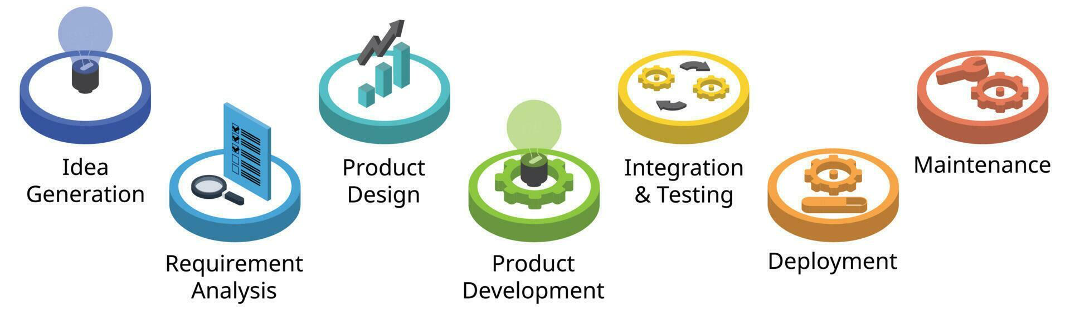
Understanding the Software Development Lifecycle
SDLC stands for Software Development Life Cycle
It is a structured process used to develop and maintain software systems
SDLC consists of a set of phases or stages that guide the software development process from start to finish
Notes:
SDLC stands for Software Development Life Cycle. It is a structured approach used in software engineering to guide the process of developing software applications. The SDLC defines a series of phases that a software project goes through, from conception to deployment and maintenance. Each phase has specific goals, activities, and deliverables, ensuring a systematic and well-organized development process.
Typical process in SDLC are:
Idea generation is the initial and crucial phase in the Software Development Life Cycle (SDLC) where new software projects are conceived. This phase involves identifying problems, opportunities, or needs that can be addressed through the development of a software solution. You need to undergo common techniques like Brainstorming, Market Research, User Feedback, Competitor Analysis, POC, Innovation workshops, etc.,
Requirement analysis in the Software Development Life Cycle (SDLC) is a crucial and systematic process of understanding, defining, and documenting the needs and expectations of stakeholders for a software project. It involves gathering, organizing, and clarifying requirements to ensure that the final software product meets the desired objectives and satisfies the users' needs. Major steps like gathering requirements, eliciting them, analyzing, organizing and documenting requirements, validating them should be performed.
Product design is a crucial phase in the Software Development Life Cycle (SDLC) where the requirements gathered during the requirement analysis phase are transformed into a detailed design specification for the software product. The design phase lays the foundation for the development process and guides the construction of the software system. More detailed design structure should be performed by the team like System Architecture Design, Detailed Design, UI design, DB design, prootyping, Security and performance considerations, design documentations, reviewing and validating them, feasibility assessment and technology selection.
Product development in the Software Development Life Cycle (SDLC) refers specifically to the process of creating and releasing a software product. It involves a series of well-defined steps to design, build, test, and deploy the software.
Integration and testing are two critical phases in the Software Development Life Cycle (SDLC) that follow the product design and development stages. These phases focus on ensuring that the individual software components or modules work together as intended and that the entire system functions as expected.
Deployment in the Software Development Life Cycle (SDLC) refers to the process of releasing the developed software to the production environment for actual use by end-users or customers. It is the final stage of the SDLC, following the completion of product design, development, integration, and testing. Deployment involves making the software available and accessible to the intended audience.
Maintenance is an essential phase in the Software Development Life Cycle (SDLC) that comes after the deployment of the software product. It involves managing, updating, and enhancing the software to ensure it continues to meet user needs, remains reliable, and stays compatible with changing environments. Maintenance encompasses various activities to keep the software in good working condition and to address issues that may arise during its operational life.

Slide 5

CIRCLE of Life
Teams come, operate, evolve and disband
People come, grow, and eventually move on
Projects come, grow, evolve and enter stasis
Your project has to accommodate these facts of project lifecycle!!
Notes:
The "Circle of Life" in the context of the Software Development Life Cycle (SDLC) refers to the continuous and iterative nature of the software development process. It signifies that software development is not a linear, one-time activity but rather a cyclical and ongoing process. The software development life cycle follows a loop-like pattern, where each completed cycle leads to the beginning of a new one.

Slide 6
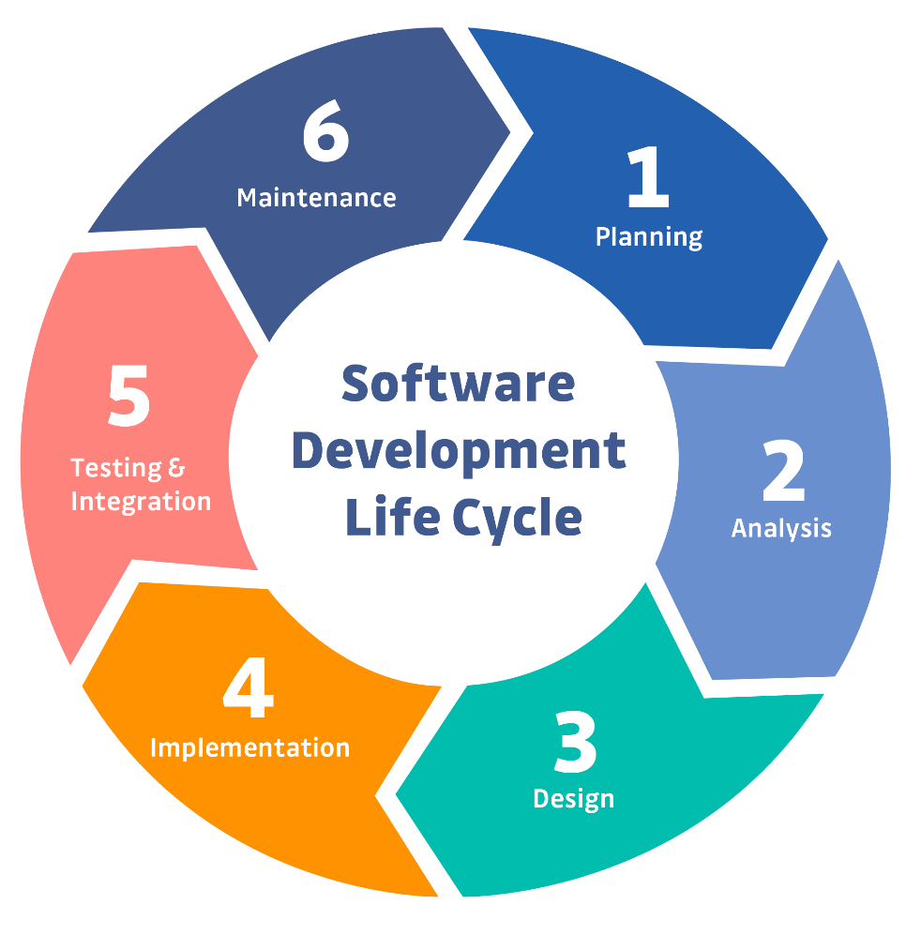
Software Development Life Cycle (SDLC): Why?
Purpose
Leads to good software
Reduces risk
Enables visibility and measurement
Enables team’s teaming
Key attributes
Outcomes of processes or products are key deliverables
Roles are clear
Pre- and post-conditions are understood and held true
Notes:
The purpose of the Software Development Life Cycle (SDLC) is to provide a structured and systematic approach to developing high-quality software products. SDLC serves as a framework that guides software development teams through a series of well-defined phases, ensuring that the software project progresses in an organized and controlled manner.
The key attributes of the Software Development Life Cycle (SDLC) define its characteristics and principles that guide the development process. These attributes are crucial for effective software development and successful project management.

Slide 7
Phases of the SDLC
The SDLC (Software Development Life Cycle) comprises several essential phases:
Requirements Gathering: Identifying and documenting project needs and objectives by consulting stakeholders.
System Analysis: Evaluating existing systems and defining requirements for the new system.
System Design: Planning the software architecture and user interface.
Coding and Implementation: Writing and integrating the code to create the software.
Testing: Executing tests to ensure the software's functionality and quality.
Deployment: Launching the software for users to access and utilize.
Maintenance and Support: Providing ongoing support, updates, and improvements to the software.
Notes:
-Requirement gathering, also known as requirements elicitation or requirements analysis, is a crucial phase in the Software Development Life Cycle (SDLC). It involves understanding, capturing, and documenting the needs and expectations of stakeholders to define the software's functional and non-functional requirements. Proper requirement gathering sets the foundation for the entire development process and ensures that the final software product meets the desired objectives.
-
-The system analysis phase is critical for setting the right direction for the software development project. It ensures that the development team has a clear understanding of the project's objectives, requirements, and constraints. The output of this phase serves as the foundation for the subsequent phases of the SDLC, including system design, implementation, testing, and deployment. Proper system analysis reduces the risk of misunderstandings and rework during development and increases the likelihood of delivering a successful software solution that meets the stakeholders' expectations.
-
-The system design phase is crucial for ensuring that the software development team has a clear plan and direction for building the software. It reduces the risk of misunderstandings and deviations during development, as the detailed design specifications serve as a reference for the implementation phase. A well-executed system design phase results in a more efficient and successful software development process, leading to the creation of a high-quality, reliable, and user-friendly software product that aligns with the stakeholders' requirements and expectations.
-
-Coding and implementation are the phases in the Software Development Life Cycle (SDLC) where the actual development of the software takes place. After the system design phase, where the software's detailed specifications are prepared, developers start writing the code to build the software product.
-
-Testing is a critical phase in the Software Development Life Cycle (SDLC) that ensures the quality, reliability, and functionality of the developed software. It involves systematically evaluating the software to identify defects, verify that it meets the specified requirements, and validate that it functions as expected. Testing is conducted at various levels of the software development process to catch issues early and provide confidence in the software's performance.
-
-Deployment in the Software Development Life Cycle (SDLC) is the phase where the developed software is released to the production environment and made available for end-users or customers. It is the final stage of the SDLC, following the completion of coding, testing, and other development activities. Deployment involves the actual implementation of the software in the live environment where it will be used.
-
-Maintenance and support are crucial phases in the Software Development Life Cycle (SDLC) that occur after the deployment of the software. These phases are focused on ensuring the ongoing functionality, reliability, and usability of the software, as well as providing assistance to users and addressing any issues that may arise.

Slide 8
Benefits of the SDLC
Increased Quality
Reduced Risk
Increased Efficiency
Improved Communication
The SDLC helps ensure that software is developed to a high standard by following a structured process
The SDLC helps reduce the risk of project failure by identifying and mitigating risks early in the process
The SDLC helps improve communication between stakeholders by defining clear roles and responsibilities
The SDLC helps improve efficiency by providing a sustainable process that can be used to develop software more quickly and effectively
Notes:
-Increased quality in the Software Development Life Cycle (SDLC) is essential to deliver software products that meet user expectations, perform reliably, and provide a positive user experience. Achieving higher quality in SDLC involves adopting various practices and strategies throughout the development process.
-
-Reducing risks in the Software Development Life Cycle (SDLC) is essential to ensure the successful delivery of software projects within budget and schedule, and to meet user expectations. Risks in SDLC can arise from various sources, including technical challenges, resource constraints, scope changes, and external factors.
-
-Improved communication is a critical aspect of the Software Development Life Cycle (SDLC) that significantly contributes to the success of a software project. Effective communication ensures that all stakeholders, including developers, project managers, clients, and end-users, have a clear understanding of the project's goals, progress, and challenges.
-
-Increasing efficiency in the Software Development Life Cycle (SDLC) is crucial for delivering software projects on time, within budget, and meeting quality standards. Improved efficiency helps streamline the development process, reduces waste, and maximizes productivity.

Slide 9




Objectives of SDLC
Ensure High-Quality Software
SDLC provides a systematic approach to software development, ensuring the creation of high-quality software products.
It emphasizes rigorous testing, quality assurance, and adherence to industry standards.
Manage Project Scope and Resources
SDLC helps in defining the project scope, requirements, and goals, enabling effective resource allocation and management.
It assists in estimating project timelines, costs, and risks, facilitating better project planning and control.
Enhance Communication and Collaboration
SDLC promotes collaboration between development teams, stakeholders, and users.
It establishes clear communication channels, facilitating effective interaction and understanding among all involved.
Ensure Customer Satisfaction
SDLC focuses on understanding and meeting customer requirements, expectations, and needs.
It helps deliver software solutions that align with user expectations, improving overall customer satisfaction.
Notes:
-Ensuring high-quality software in the Software Development Life Cycle (SDLC) is highly important to deliver reliable, efficient, and user-friendly products. You need to follow some key practices for high quality software with thorough requirement analysis, effective design and architecture, code reviews, unit testing and test-driven development, integration testing and system testing, user acceptance testing, test automation, security testing, performance testing, usability testing, etc.,
-
-Managing project scope and resources effectively in the Software Development Life Cycle (SDLC) is another major objective for delivering successful software projects on time and within budget. You need to follow strategies like defining clear project scope, create a work breakdown structure, use agile and iterative development, set realistic project goals etc.,
-
-Enhancing communication and collaboration in the Software Development Life Cycle (SDLC) is for improving team productivity, reducing misunderstandings, and delivering successful software projects.
-
-Customer satisfaction is a key measure of success in the Software Development Life Cycle (SDLC). It refers to the level of fulfillment and contentment that customers or end-users experience with the software product delivered by the development team. Ensuring high customer satisfaction is essential because satisfied customers are more likely to continue using the software, recommend it to others, and provide valuable feedback for future improvements.
-

Slide 10
Benefits of a Structured SDLC Process
Improved Project Management
Enhanced Quality Assurance
Effective Communication
Better planning and tracking of project progress, efficient utilization of resources, and timely delivery
Early identification and resolution of defects, consistent and reliable software output
Clear communication among team members and stakeholders, reduced misunderstandings and misinterpretations
Risk Mitigation
Cost and Time Efficiency
Identification and management of project risks, increased chances of project success
Accurate estimation and allocation of resources, minimized rework and cost overruns
Notes:
A structured Software Development Life Cycle (SDLC) process offers numerous benefits to development teams, stakeholders, and the overall software development project. Some of the key benefits of following a structured SDLC process include:
Improved Project Planning: A structured SDLC process allows for better project planning, as it defines clear phases, milestones, and deliverables. This helps in setting realistic timelines, allocating resources effectively, and managing stakeholders' expectations.
Enhanced Quality Assurance: By following a well-defined process, teams can implement thorough testing and quality assurance measures at each stage of development. This reduces the likelihood of defects and ensures a higher quality final product.
Efficient Resource Allocation: A structured SDLC process helps in identifying resource requirements early in the project. This allows for better resource allocation and utilization, reducing the risk of resource shortages or inefficiencies.
Risk Mitigation: Structured SDLC processes include risk assessment and mitigation strategies. Identifying potential risks early on enables teams to address them proactively, reducing the impact on project timelines and outcomes.
Improved Communication and Collaboration: A structured process encourages regular communication and collaboration among team members and stakeholders. This fosters a shared understanding of project goals and facilitates smooth information flow.

Slide 11

Software Development Methodologies
There are a number of different software development methodologies including
Waterfall
Agile
Rapid application development (RAD)
Extreme programming (XP)
Rational unified process (RUP)
Scrum
Notes:
Waterfall methodology – a sequential, activity-based process in which each phase in the SDLC is performed sequentially from planning through implementation and maintenance
Rapid application development methodology (RAD) – emphasizes extensive user involvement in the rapid and evolutionary construction of working prototypes of a system to accelerate the systems development process
Extreme programming (XP) methodology – breaks a project into tiny phases, and developers cannot continue on to the next phase until the first phase is complete
Agile methodology – a form of XP, aims for customer satisfaction through early and continuous delivery of useful software components

Slide 12
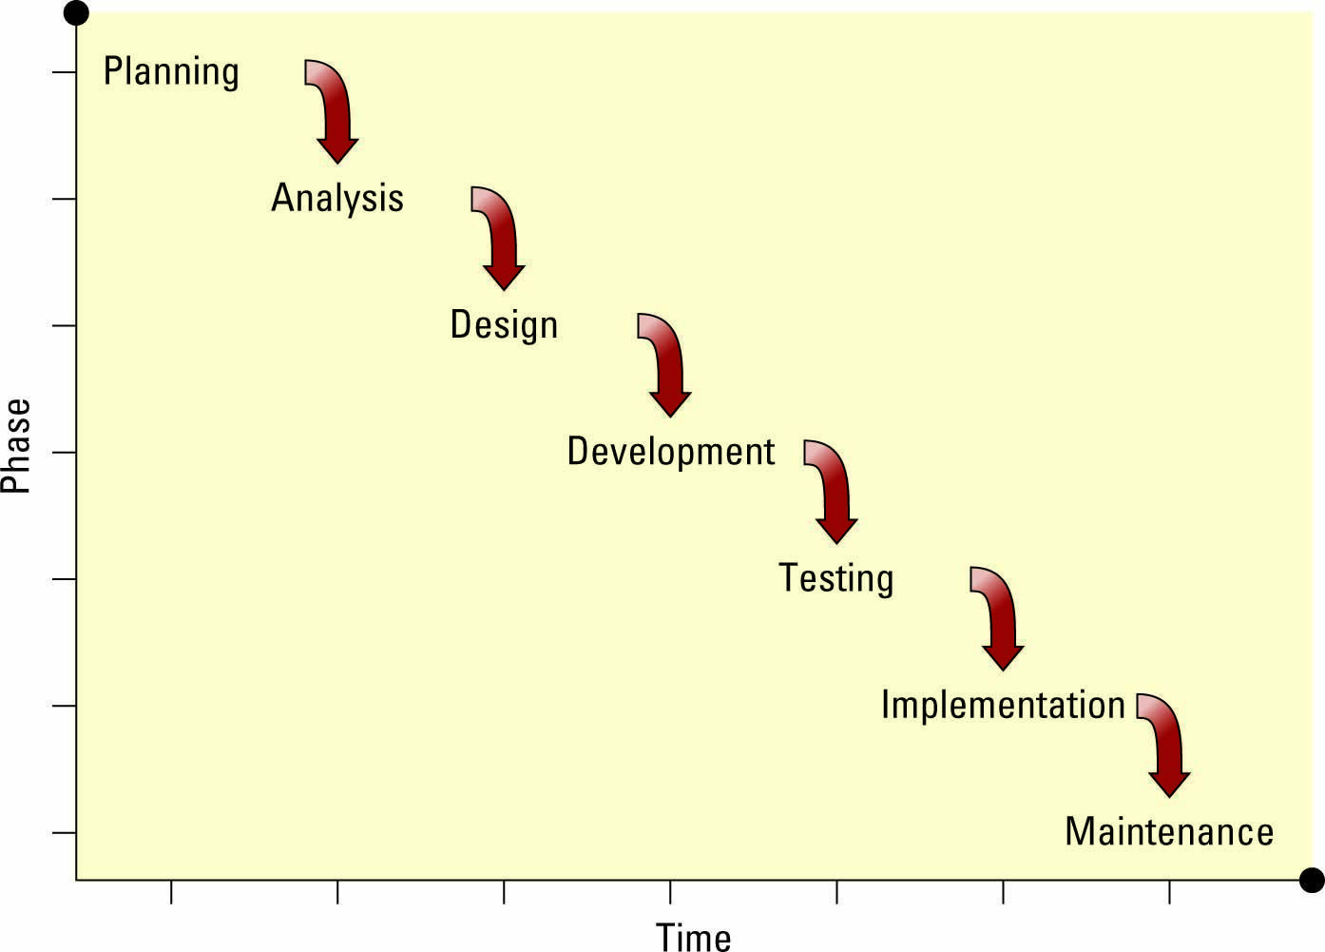
Waterfall Methodology
Waterfall methodology – A sequence of phases in which the output of each phase becomes the input for the next
Notes:
The waterfall methodology is one of the oldest software development methods and has been around for more than 30 years
The success rate for software development projects that follow this approach is only about 10 percent, or 1 in 10
The biggest problem with the waterfall methodology is that it assumes users can specify all business requirements in advance
Ask your students to define another issue with the waterfall methodology
Ans: It also assumes that business requirements do not change over time
Stress to your students that if they ever find themselves on a software development project that is using the waterfall methodology, they should do everything they can to change the methodology
●Waterfall methodology – a sequential, activity-based process in which each phase in the SDLC is performed sequentially from planning through implementation and maintenancee in modern software development practices.

Slide 13

In the beginning…
Waterfall.
Requirements
Analysis
Design
Implementation
Testing
Deployment
6 months

Slide 14

Agile Methodology
Iterative development – Consists of a series of tiny projects
Agile methodology – Aims for customer satisfaction through early and continuous delivery of useful software components developed by an iterative process using the bare minimum requirements
Notes:
The Agile Alliance is a group of software developers whose mission is to improve software development processes and whose manifesto includes the following:
Satisfy the customer through early and continuous delivery of valuable software
Welcome changing requirements, even late in development
Business people and developers must work together daily throughout the project
Build projects around motivated individuals
The best architectures, requirements, and designs emerge from self-organizing teams
At regular intervals, the team reflects on how to become more effective, then tunes and adjusts its behavior accordingly
●
●Agile methodology – a form of XP, aims for customer satisfaction through early and continuous delivery of useful software components

Slide 15
Rapid Application Development Methodology (RAD)
Rapid application development methodology– Emphasizes extensive user involvement in the rapid and evolutionary construction of working prototypes of a system to accelerate the systems development process
Prototype – A smaller-scale representation or working model of the users’ requirements or a proposed design for an information system
The prototype is an essential part of the analysis phase when using a RAD methodology
Notes:
RAD is a more popular route for system development projects
The fundamentals of RAD include:
Focus initially on creating a prototype that looks and acts like the desired system
Actively involve system users in the analysis, design, and development phases
Accelerate collecting the business requirements through an interactive and iterative construction approach
●Rapid application development methodology (RAD) – emphasizes extensive user involvement in the rapid and evolutionary construction of working prototypes of a system to accelerate the systems development process
●Extreme programming (XP) methodology – breaks a project into tiny phases, and developers cannot continue on to the next phase until the first phase is complete.
●RUP provides a comprehensive and adaptable framework for software development. It is particularly suited for large-scale and complex projects where flexibility and iterative development are essential. However, RUP's comprehensive nature may require a significant amount of planning and documentation, making it less suitable for smaller projects with limited resources. In recent years, Agile methodologies have gained popularity for their more lightweight and adaptable approach, but RUP's principles and practices continue to influence software development processes.
●Scrum is well-suited for projects with evolving requirements, a dynamic environment, and a need for continuous feedback. It promotes agility, transparency, and customer satisfaction, making it a popular choice

Slide 16
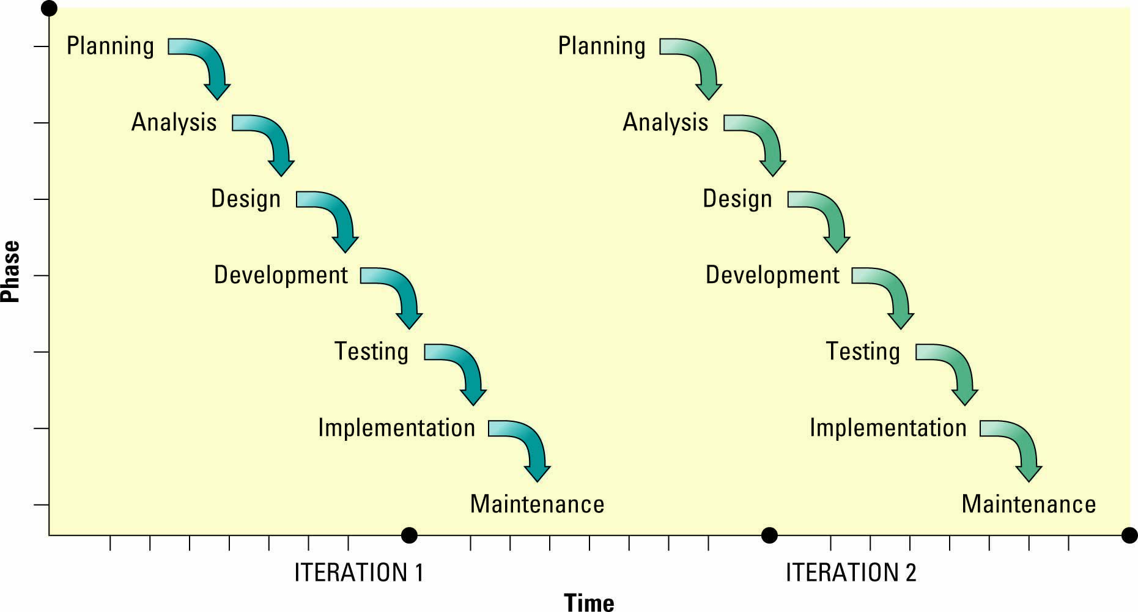
Extreme Programming Methodology
Extreme programming (XP) methodology – Breaks a project into tiny phases, and developers cannot continue on to the next phase until the first phase is complete
Notes:
The primary difference between the waterfall and XP methodologies is that XP divides its phases into iterations with user feedback.
●Extreme programming (XP) methodology – breaks a project into tiny phases, and developers cannot continue on to the next phase until the first phase is complete.

Slide 17

Rational Unified Process (RUP) Methodology
Rational unified process (RUP) – Provides a framework for breaking down the development of software into four gates
Gate one: inception
Gate two: elaboration
Gate three: construction
Gate four: transition
Notes:
RUP is an iterative methodology, the user can reject the product and force the developers to go back to gate one. Approximately 500,000 developers have used RUP in software projects of varying sizes in the 20 years it’s been available, according to IBM. RUP helps developers avoid reinventing the wheel and focuses on rapidly adding or removing reusable chunks of processes addressing common problems.
RUP provides a comprehensive and adaptable framework for software development. It is particularly suited for large-scale and complex projects where flexibility and iterative development are essential. However, RUP's comprehensive nature may require a significant amount of planning and documentation, making it less suitable for smaller projects with limited resources. In recent years, Agile methodologies have gained popularity for their more lightweight and adaptable approach, but RUP's principles and practices continue to influence software development processes.

Slide 18
Agile Scrum
Emphasis on small, semi-independent teams ideally delivering discrete pieces of a system. Team ideally has total responsibility for the components it produces.
Team
Small, cross-functional, self-organizing units
Scope
Small deliverable scope delivered in consensus priority order
Priorities can be adjusted (typically at sprint start)
Timeline
Small iterations (2-3 weeks is typical) emphasizing delivery at the end
Notes:
Because RUP is an iterative methodology, the user can reject the product and force the developers to go back to gate one. Approximately 500,000 developers have used RUP in software projects of varying sizes in the 20 years it’s been available, according to IBM. RUP helps developers avoid reinventing the wheel and focuses on rapidly adding or removing reusable chunks of processes addressing common problems.

Slide 19

SCRUM Methodology
Scrum – Uses small teams to produce small pieces of deliverable software using sprints, or 30-day intervals, to achieve an appointed goal
Under this methodology, each day ends or begins with a stand-up meeting to monitor and control the development effort
Notes:
Scrum provides a framework for continuous improvement, allowing teams to adapt to changing requirements, customer feedback, and market dynamics. The iterative nature of Scrum allows for frequent inspection and adaptation, enabling teams to deliver high-quality products and respond to changes quickly.
Overall, Scrum is a widely used and effective framework for managing software development projects. It promotes collaboration, transparency, and customer satisfaction, making it a popular choice among Agile methodologies for modern software development.

Slide 20

Minimizing waste and maximize feedback

Slide 21
The difference between what I think is valuable and what is really valuable creates waste
Waste

Slide 22


Paul the master gardener, has a intuitive sense of what needs to be done next. He knows in his bones what matters and what doesn’t.
I might think perfectly straight rows are really important. I put a lot of effort into making my rows straight.
Along comes Paul and says "Why are you working so hard at making the rows straight? What you need is more compost."
Paul

Slide 23
Software development is full of waste of overproduction
Fat requirement documents that rapidly grow obsolete
Elaborate architectures that are never used
Code that goes months without being integrated, tested and executed in a production environment
Documentation no one reads until it is irrelevant or misleading
While all these activities are important to software development, we need to use their output immediately in order to get the feedback we need to eliminate waste
Notes:
People get passionate about coding style. While there are undoubtedly better styles and worse styles. The most important style issue is that team chooses to work towards a common style.
If everyone on the team chooses to focus on what’s important to the team, what is they should focus on? XP embraces five values to guide development:
Simplicity
Communication
Feedback
Courage
Respect

Slide 24
The Toyota Story
Controlling waste

Slide 25

Taiichi Ohno
Industrial engineer with Toyota
Post WWII reconstruction
Goal of competing with US auto industry
Limited resources
Focus on controlling what could be controlled
Believed in the potential of the team
“Progress cannot be generated when we are satisfied with existing solutions.”
- Taiichi Ohno
Notes:
KEY POINTS:
Let’s look at the foundations of Operational Excellence…where it came from.
After World War II, the infrastructure of Japan had been devastated.
Resources were VERY scarce. Having to rebuild factories left very little for actual production.
Taiichi Ohno was an industrial engineer in one of Toyota’s factory.
He was challenged with the goal of competing with the US’s auto industry, which was experiencing a boom in growth after the war: plenty of resources available for their production.
Ohno focused on an intense focus of controlling what could be controlled. Eliminate all waste. Do not allow individuals to do redundant work. Reduce all non-productive work.
Ohno also believed in the potential of the team. Give them a goal and then drive them to find the best way to achieve it.
His factory was the only one to turn a profit. Other factory managers thought he was falsifying his results. Government did an audit and found paperwork to be accurate.
Took his strategy for success and shared it with other factories. Saved the Toyota business and influenced much of Japan’s economic recovery.
Invented Kanban: One of the main goals of Kanban is to limit the build-up of excess inventory at any point on the production line.

Slide 26
/reads/toyota
github.com/the-code-camp/stem-sdlc/
Notes:
https://github.com/the-code-camp/stem-sdlc/tree/main/reads/toyota

Slide 27
Activity: Toyota story
How is the waste controlled in Toyota?
List some of the advantages to the organization by controlling waste.
Suggest some of ways how waste can be controlled in software development
Notes:
Activity: 20 minutes

Slide 28
Thank You

